Slide 1



Designing a Mach 5 Wind Tunnel
Treyton Moore
Thank you to Dr. Alex Craig, Dr. Lutz Taubert, John Flood and Isaac Charcos for their guidance and assistance in this process.
Thank you to the Office of Naval Research (ONR) and the Air Force Office of Scientific Research (AFOSR) for their continued funding.

Slide 2
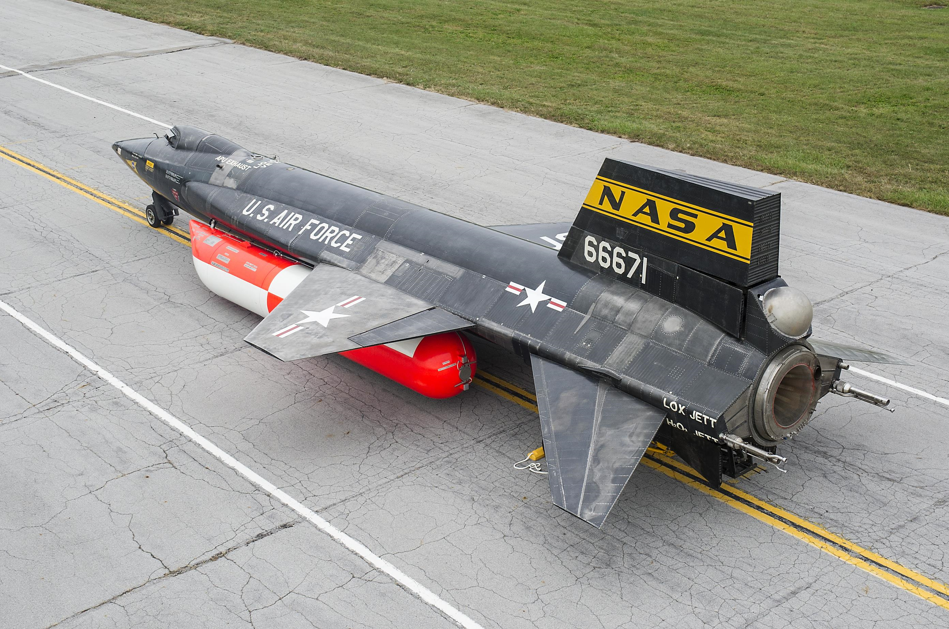
Terminology Introduction
Quiet – good approximation to calm conditions encountered by aircraft in the atmosphere
Mach # -- multiplier on the speed of sound in order to denote different flight regimes
Hypersonic – >= 5x the speed of sound.
North American X-15A-2. Photo courtesy of the National Museum of the US Air Force. Shot by Ken LaRock.

Slide 3
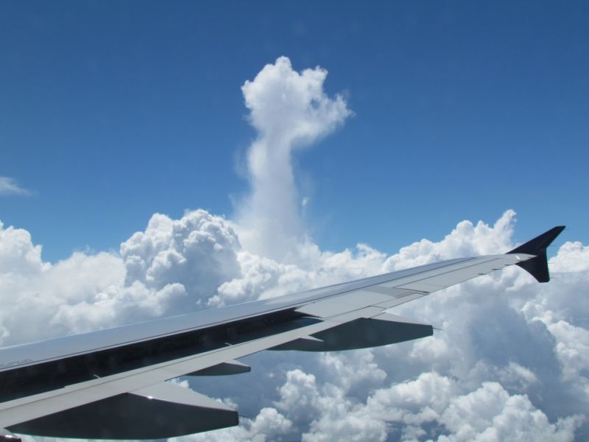
Motivation and Comparison
Increased flight speeds => reduced time in flight
Missile systems more capable of eliminating enemy threats
Commercial airliners travel just below Mach 1
Fighter jets – above 1, but nowhere near Mach 5
Photo from The Vane online blog. Taken by Dennis Mersereau.

Slide 4
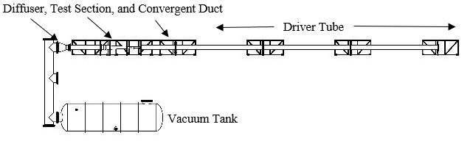
Current Setup
Mach 4 Ludwieg Tube – working towards “quiet” conditions
Observing the interactions between Mack-Mode Instabilties. Unsure which of the first two modes is dominant at this regime.

Slide 5
Diaphragms
Mach 4 Tunnel – Two mylar diaphragms separated by a distance of ~1 ft, each can withstand pressure differences of up to 25 psi (dependent on thickness)
Alternative strategies to using diaphragms

Slide 6
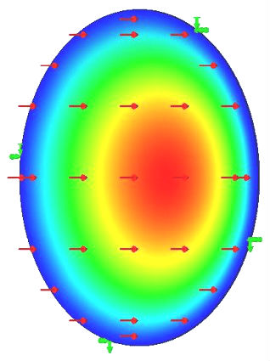
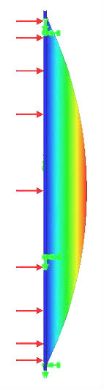
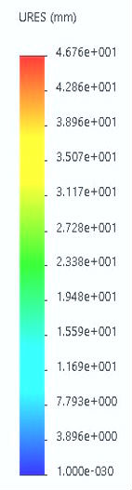
Diaphragm Modeling and Simulations
Tested materials include Al 3003, Al 6061-O , Al 6061-T6.
Selected for their moduli and ultimate tensile strengths
Result: ¼” thick Al 3003 - burst pressure ~240 PSID. Al 6061s not much different
Displacement on right
Preliminary design

Slide 7
Diaphragm Modeling and Simulations (cont.)
After the preliminary round of testing, we looked into scoring the diaphragms
X-Men symbol for predictable pattern
Still deciding how/where to have these manufactured (in-house/externally)

Slide 8
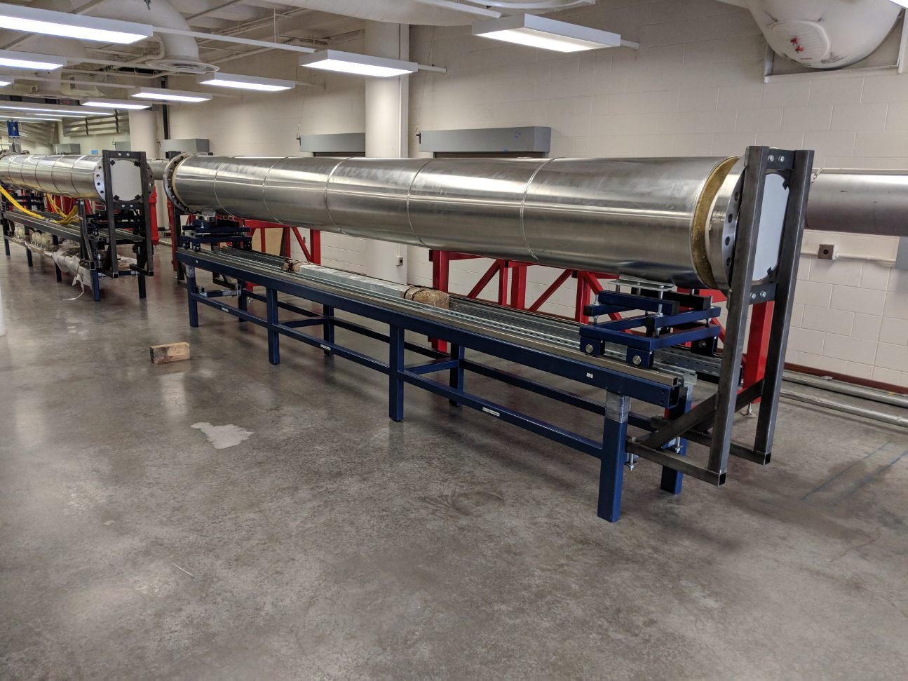
Results
Tunnel currently undergoing installation
Retrieve data on burst pressures to support (or reject) the results provided by the simulation software

Slide 9
Thank You

Slide 10
Acknowledgements & Resources
Photos
Anderson, John (2006). Hypersonic and High-Temperature Gas Dynamics (Second ed.). AIAA Education Series.
https://www.latimes.com/business/la-fi-hypersonic-development-20180221-story.html
http://thevane.gawker.com/stop-complaining-about-flying-and-look-out-the-window-i-1632594608
https://www.nationalmuseum.af.mil/Visit/Museum-Exhibits/Fact-Sheets/Display/Article/195761/north-american-x-15a-2/

